Slide 1
Engineer Speaking Club
Node.js test runner

Slide 2
Agenda
Assert module in Node.js
What is Node.js test runner?
Node.js test runner features
Q&A session
Notes:
Let's look at today's agenda.
The first thing we will pay attention to is nodejs assert module, since we will use it further and it is desirable to have an idea of what it is. Then we will go directly to our topic, we will answer the question What is Node.js test runner. After that, we will move on to the editor code, where we will look at some features of the test runner, how to run it, and discuss its strengths and weaknesses. And at the end, you can ask your questions, and I will try to answer them.
So let’s start

Slide 3
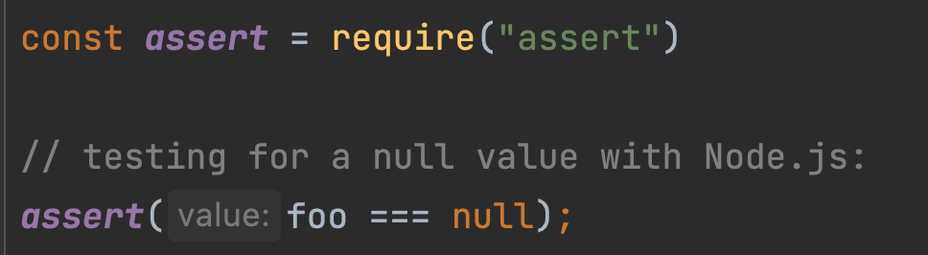
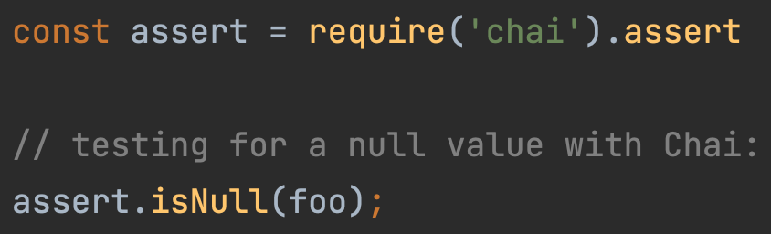
Assert module in Node.js
The assert module in Node.js is used to test expressions for the functionalities in Node.js applications. If the result of the test returns false, assert throws an error and stops the program.
Notes:
Assert is a Node's built-in module that can be used in your application code via simple require. It gives you lots of assertions which used to test expressions in Node.js applications. If the result of the test returns false, assert throws an error and stops the program. So basically It makes testing process much easier.
It will become clearer if I give an example. Assert module has a very popular analogy that I think you've heard of. It is Chai. Chai and build in assert module is the same things. The only reason why chai's assert exist is so if you read the code you can get a better understanding of the tests.
By looking on screenshots on your screen you can see some examples. On the left side we testing variable foo for a null value with node’s assert module and on the right we do the same with chai.
And so I hope each of you now has an idea of ​​what an assert module is, let's move on

Slide 4
What is Node.js test runner?
Test runner - is a new feature in Node.js 18 that offers a quick and easy way to run a test suite without any additional dependencies.
There’s “skip/only” and “sub-tests/test suite” concepts
It’s not intended to replace full featured alternatives like Jest or Mocha
Notes:
Let’s try to answer next question what is Node.js test runner?
The eighteenth version of the node was released on the nineteenth of April and brought with it a few new features. and test runner is one of the new features. It’s not intended to replace full featured alternatives like Jest or Mocha, but does offer a quick and easy way to run a test suite without any additional dependencies.
The built-in test runner supports subtests, test skipping, limited test runs, callback tests And some other features that we will look at in the code editor
so, to not waste time, let's go there and see what this tester is

Slide 5
Node.js test runner features - introduction
The test runner module is available under node: scheme. node:test exports a test function and you can run the Node CLI with a --test flag which does some basic search/matching for test files.
^test$ - Files whose basename is the string 'test'.
^test-.+ - Files whose basename starts with the string 'test-'
.+[\.\-\_]test$ - Files whose basename ends with .test, -test, or _test
If a directory named test is encountered, the test runner will treat all files inside as test files.

Slide 6
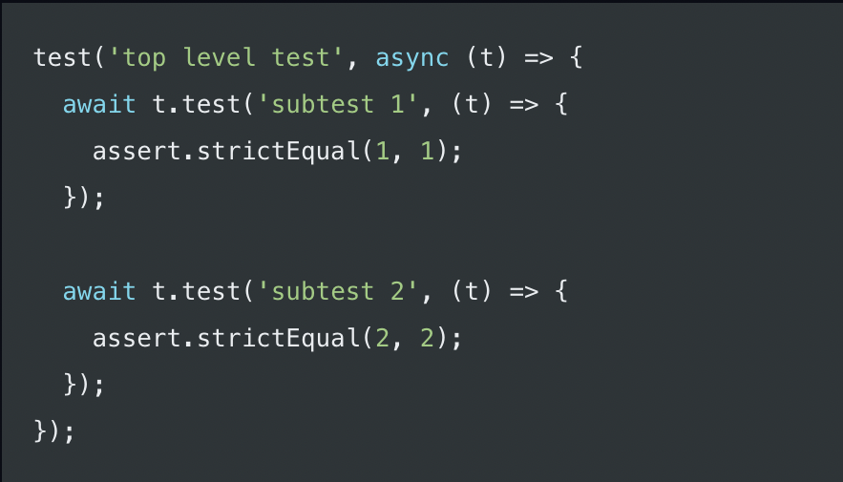
Node.js test runner features - subtests
Subtest - is a a test that is part of a larger test. Test context's test() method allows subtests to be created.
await is used to ensure that both subtests have completed. This is necessary because parent tests do not wait for their subtests to complete.

Slide 7
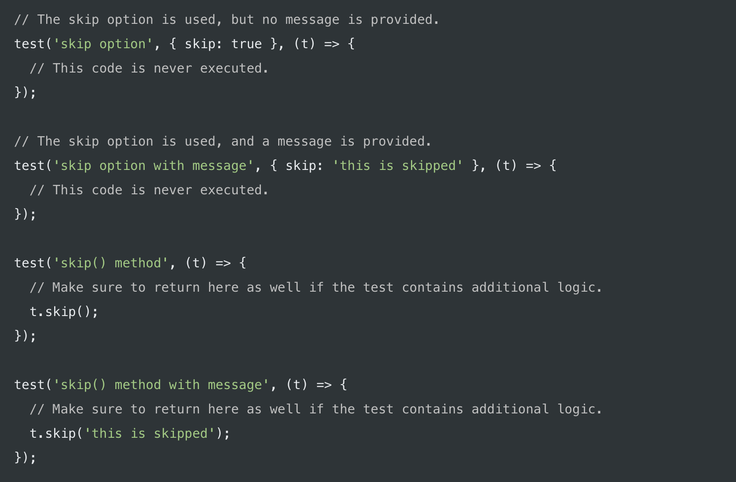
Node.js test runner features - options
The test function takes in an optional options object as the second parameter, among which are: skip, todo, only, concurrency, timeout.

Slide 8
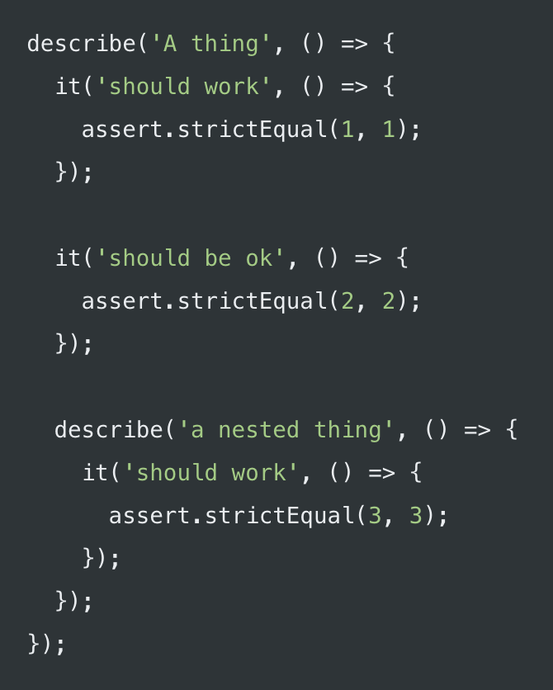
Node.js test runner features - allias
Running tests can also be done using describe to declare a suite and it to declare a test.
describe and it are imported from the node:test module

Slide 9
Useful resources
Test runner - https://nodejs.org/api/test.html#test-runner
TAP output - https://testanything.org/
Assert module - https://nodejs.org/api/assert.html
Spying and stubbing - https://sinonjs.org/

Slide 10
Questions
For more information please visit:
www.leverx.com

Slide 11
Thank you!
For more information please visit:
www.leverx.com
Notes:
In the end, I would like to say a few words about this innovation. The Node.js experimental tester in my opinion is a nice built-in way to write tests. However, it is still experimental, so I don’t recommend using it for production projects because the API could change at any time. but the experimental tester is a nice one to try. I do recommend learning the test module, and once it’s more stable, maybe to use in your projects. Especially if someone makes a nice consumer for the TAP output.

